Slide 1

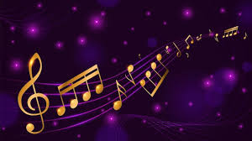
Lyrics Generator: Deep Learning for Artist and Sentiment-Driven Lyrics Composition
Ashritha Kumari B, Dhrumil Shah, Himant Goyal, Ramya Sudireddy, Shashank Shashishekhar Reddy

Slide 2
Introduction
Pushing Boundaries in AI for Creative Expression
Desire to explore AI applications in the creative domain, specifically in music.
Focus on generating artist-specific lyrics for a unique creative process.
Bridging the gap between technology and artistry.
Contribution to the digital transformation in the music industry.
Nurturing Artistic Inspiration
Introduction to AI-driven text generation models.
Unique focus on generating artist-specific lyrics.
Empowering songwriters and inspiring new artists.
Contribution to the evolving digital landscape of the music industry.

Slide 3
Project Motivation
Recognizing the various AI-driven text generation models and their contributions.
Emphasizing the unique dimension added by focusing on artist-specific lyric generation, bridging the gap between technology and artistry.
Acknowledgment of the existing AI-driven text generation models and the need for a more artist-specific approach.
Expressing the project's goal of offering a tool that aids songwriters and serves as a source of inspiration for new and aspiring artists.

Slide 4
Problem Statement
Problem 1
The current state of AI applications in the creative domain, particularly in music, lacks a focus on generating artist-specific lyrics that capture the distinctive style and themes of individual artists
Problem 2
There is a gap between technology and artistry in the context of AI-driven text generation models, and this project aims to bridge that gap.
Problem 3
Create an AI-driven lyric generation system capable of infusing emotional intelligence, adapting the tone and sentiment of lyrics to evoke specific emotions, enhancing the overall impact of the song.

Slide 5
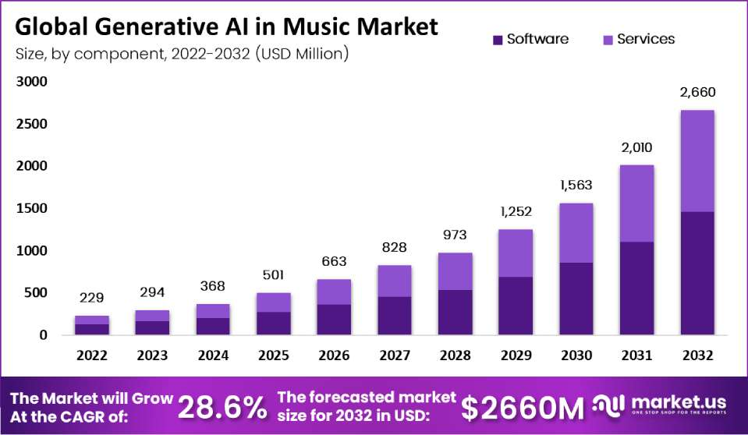
Market analysis

Slide 6
Data Collection
https://www.kaggle.com/datasets/carlosgdcj/genius-song-lyrics-with-language-information
This immense collection is sourced from Kaggle and originating from Genius, a collaborative platform for annotating creative works, consisting of a tremendous amount of 5 million songs.
This dataset contains information as recent as 2022 scraped from Genius, a place where people can upload and annotate songs, poems and even books (but mostly songs).
The dataset collected is in CSV format, which is carefully documented with several columns namely artist names, genre tags, titles, publication year, number of views, and language.

Slide 7
Data Pre-Processing
Eliminated the inconsistencies in the data, removed null, white spaces and duplicates, etc.
Removed the non-lyrical data which was not required for model training based on scope.
Grouped the data based on popular artists and tags.
Performed EDA.

Slide 8
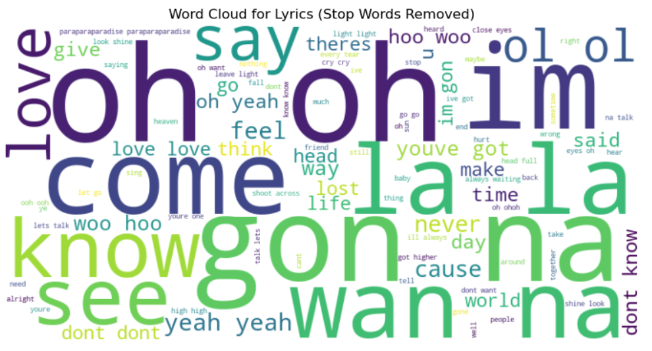
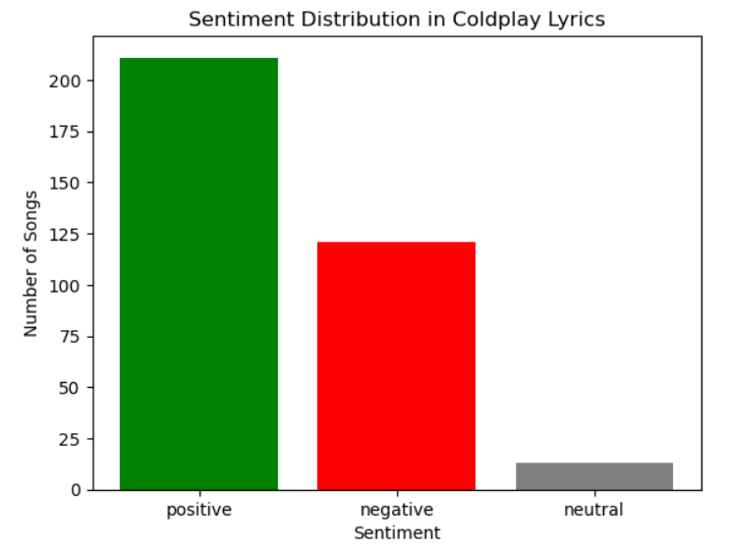
Exploratory Data Analysis

Slide 9
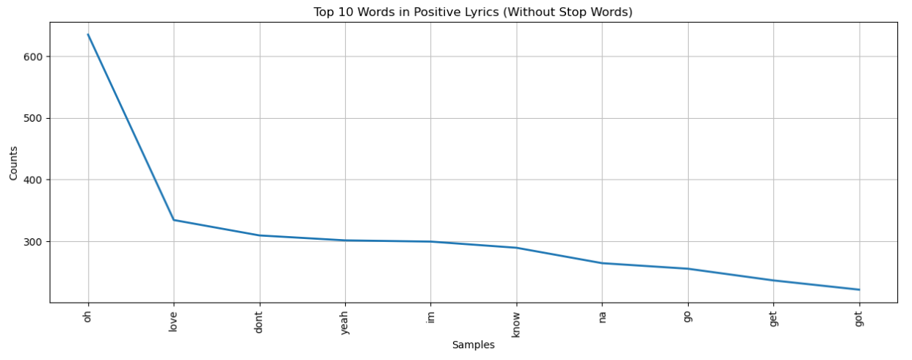
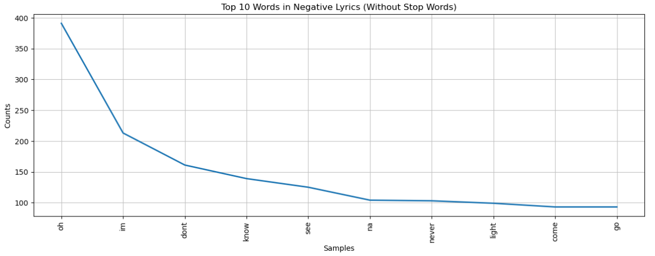
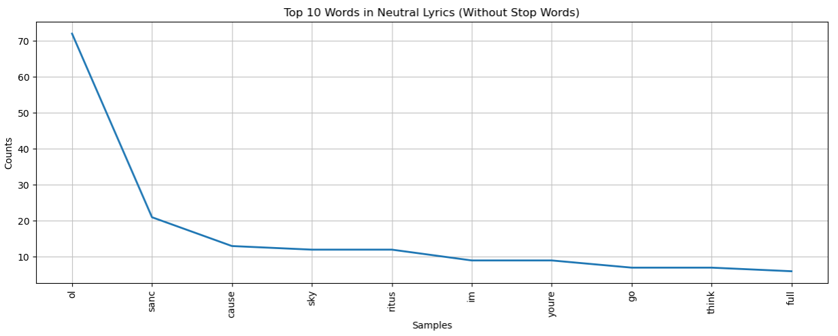
Exploratory Data Analysis

Slide 10
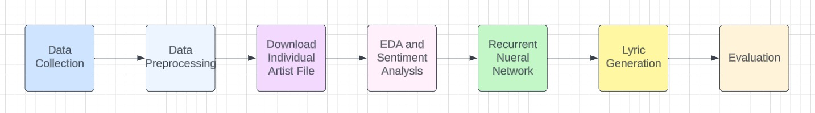
Model Development
Embedding Layer: Convert characters into numerical vectors for effective information representation.
Gated Recurrent Unit (GRU) Layer: Capture dependencies within lyrics, addressing the vanishing gradient problem.
Dense Layer: Process GRU outputs for final abstraction and logits generation
Flow Diagram

Slide 11
Evaluation
Employ quantitative metrics like Bleu Score with the chencherry.method1..
Bleu1 Score: 0.004
Metrics derived from a previous paper was used to get the Lyrics Quality Score, Rhyme Density Score and Sentiment Score
Lyrics Quality Score:
Rhyme Density Score:
Sentiment Score

Slide 12
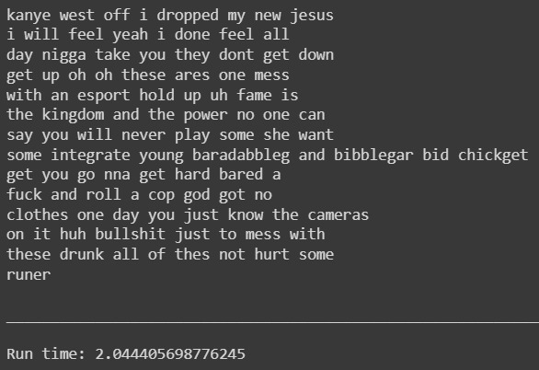
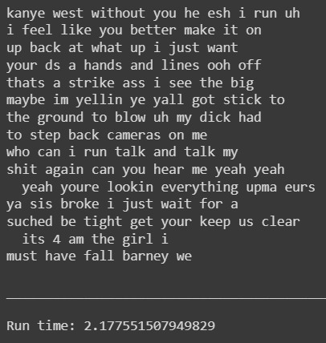
Results
Kanye West epoch 20 Kanye West epoch 30

Slide 13
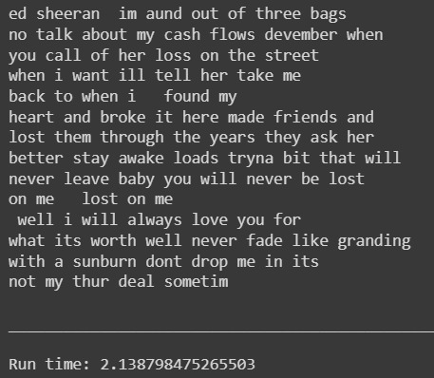
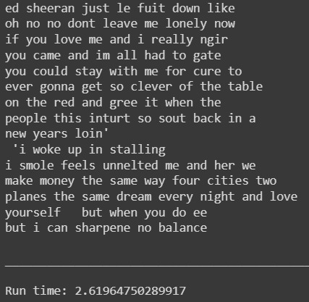
Results
Ed Sheeran epoch 20 Ed Sheeran epoch 30

Slide 14
Conclusion and Future Scope
Demonstrated promising results with RNN in artist-specific lyric generation.
Successful capture of intricate nuances, including vocabulary, rhyme schemes, and thematic elements.
Generated lyrics exhibit coherence and authenticity, resembling distinctive artist traits.
Project highlights the power of machine learning in natural language processing for music creativity.
Future directions include lyric customization, genre experimentation, and audio synthesis from lyrics.

Slide 15
Thank you

